Slide 1
Welcome to
—21000201—
Operating Systems
Part 0：Introduction to OS
Fall 2016
USTC-21000201-OPERATING SYSTEMS; FALL 2016; INSTRUCTOR: LINGBO WEI

Slide 2
Part 0: Introduction to OS
A Story
Role of an OS
OS Architecture
OS History and Features
Types of OS
USTC-21000201-OPERATING SYSTEMS; FALL 2016; INSTRUCTOR: LINGBO WEI

Slide 3
Organizing Computer Functionality
Many kinds of computer devices and technologies
  e.g., register, cache, memory, disk, tape, etc.
Many different applications
  e.g., doc, email, web, mp3, movie, etc.
Computer architecture
  How should different pieces be organized?
  How should different pieces interact?
USTC-21000201-OPERATING SYSTEMS; FALL 2016; INSTRUCTOR: LINGBO WEI

Slide 4
A Naïve Architecture
Application
doc
web
mp3
movie
Storage
Media
disk
tape
flash
new application has to interface to all existing storage media
  adding new application requires O(m) work, m = number of storage media
new storage media requires all existing applications be modified
  adding new media requires O(a) work, a = number of applications
total work in system O(ma) → eventually too much work to add apps/media
application end points may not be on the same media!
  i.e., a networking application, e.g., web, email, HTTP, etc.
USTC-21000201-OPERATING SYSTEMS; FALL 2016; INSTRUCTOR: LINGBO WEI

Slide 5
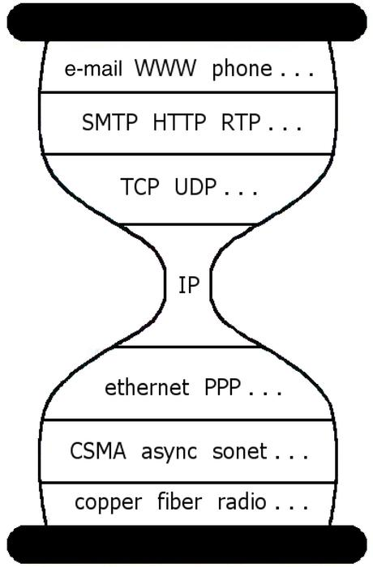
Solution: Indirection
Solution: introduce an intermediate layer that provides a single abstraction for various storage technologies
  O(1) work to add app/media
  Indirection is an often used technique in computer science
Application
doc
web
mp3
movie
Intermediate
layer
Storage
Media
disk
tape
flash
USTC-21000201-OPERATING SYSTEMS; FALL 2016; INSTRUCTOR: LINGBO WEI

Slide 6
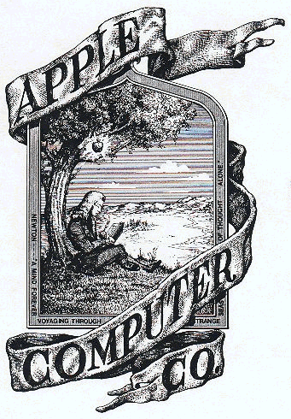
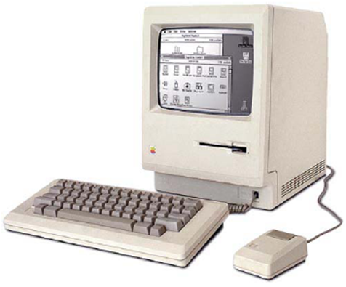

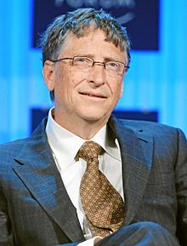
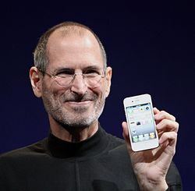


A Real Story
1981
Steve Jobs (Apple) vs. Bill Gates (Microsoft)
The first Macintosh PC
USTC-21000201-OPERATING SYSTEMS; FALL 2016; INSTRUCTOR: LINGBO WEI
Notes:
见浪潮之巅第六章Microsoft的故事，当时Jobs和Gates都只有26岁

Slide 7
Part 0: Introduction to OS
A Story
Role of an OS
  One layer in a computer system architecture
  Top-down view: convenient user interface
  Bottom-up view: efficient resource manager
  Design an OS
OS Architecture
OS History and Features
Types of OS
USTC-21000201-OPERATING SYSTEMS; FALL 2016; INSTRUCTOR: LINGBO WEI

Slide 8
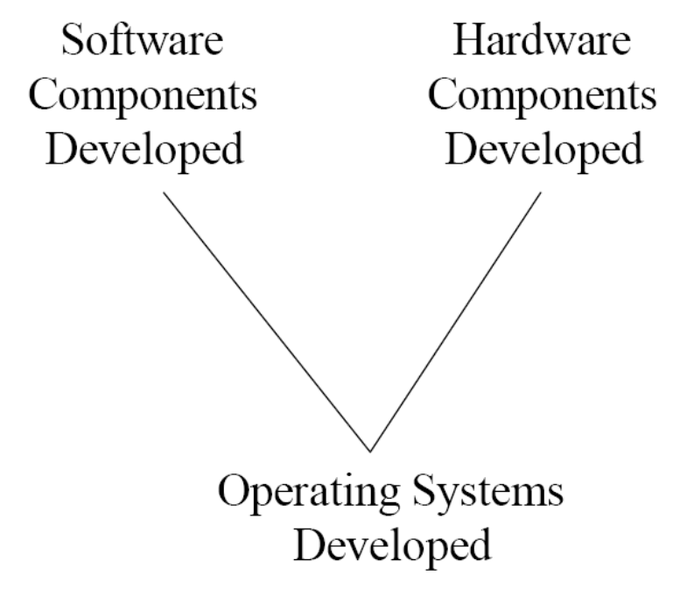
From Computer System to OS
计算机系统的构成：硬件，软件
观察OS的两个视角：
  从硬件的角度：资源的管理者 ⇒ 统一于：
  从软件的角度：服务的提供者 管理就是服务
Virtual Machine
Interface
Application
Operating System
Hardware
Physical Machine
Interface
USTC-21000201-OPERATING SYSTEMS; FALL 2016; INSTRUCTOR: LINGBO WEI

Slide 9
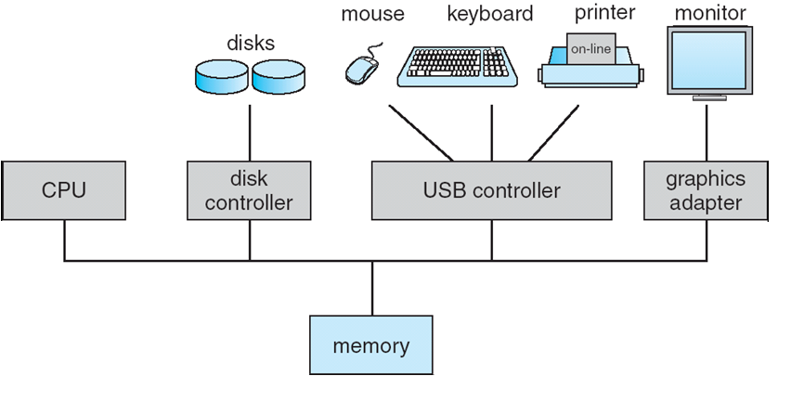
Computer Hardware
Computer System
USTC-21000201-OPERATING SYSTEMS; FALL 2016; INSTRUCTOR: LINGBO WEI

Slide 10
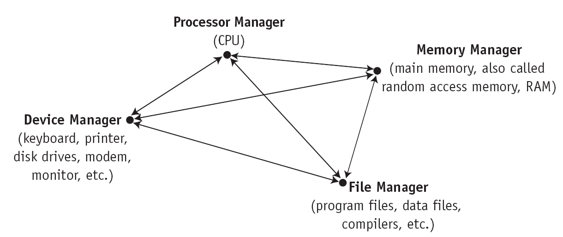
What does an Operating System do?
Coordinator and Traffic Cop (An OS is Similar to a government):
  Manages all resources
  Settles conflicting requests for resources
  Prevent errors and improper use of the computer
Most Likely:
  CPU Scheduling
  Memory Management
  File Management
  I/O Management
  Communications? (Does Email belong in OS?)
USTC-21000201-OPERATING SYSTEMS; FALL 2016; INSTRUCTOR: LINGBO WEI

Slide 11
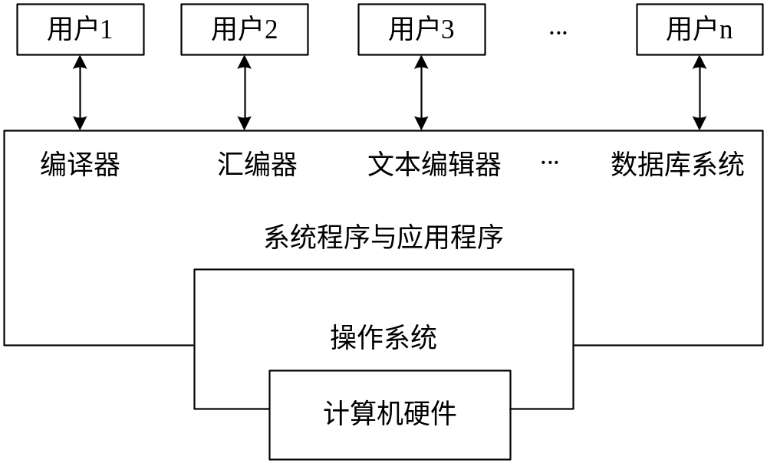
What does an Operating System do?
Facilitator (“useful” abstractions):
  Provides facilities/services that everyone needs
  Standard Libraries, Windowing systems
  Make application programming easier, faster, less error-prone
USTC-21000201-OPERATING SYSTEMS; FALL 2016; INSTRUCTOR: LINGBO WEI

Slide 12
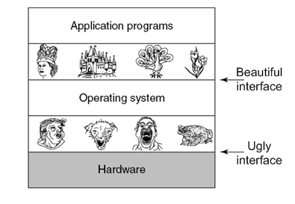
The Operating System as an Extended Machine
Operating systems turn ugly hardware into beautiful abstractions
Virtual Machine
Interface
Application
Operating System
Hardware
Physical Machine
Interface
USTC-21000201-OPERATING SYSTEMS; FALL 2016; INSTRUCTOR: LINGBO WEI

Slide 13
Virtual Machines
Software emulation of an abstract machine
  Make it look like hardware has features you want
  Programs from one hardware & OS on another one
Programming simplicity
  Each process thinks it has all memory/CPU time
  Each process thinks it owns all devices
  Different Devices appear to have same interface
  Device Interfaces more powerful than raw hardware
    Bitmapped display ⇒ windowing system
Fault Isolation
  Processes unable to directly impact other processes
  Bugs cannot crash whole machine
Protection and Portability
  Java interface safe and stable across many platforms
USTC-21000201-OPERATING SYSTEMS; FALL 2016; INSTRUCTOR: LINGBO WEI

Slide 14
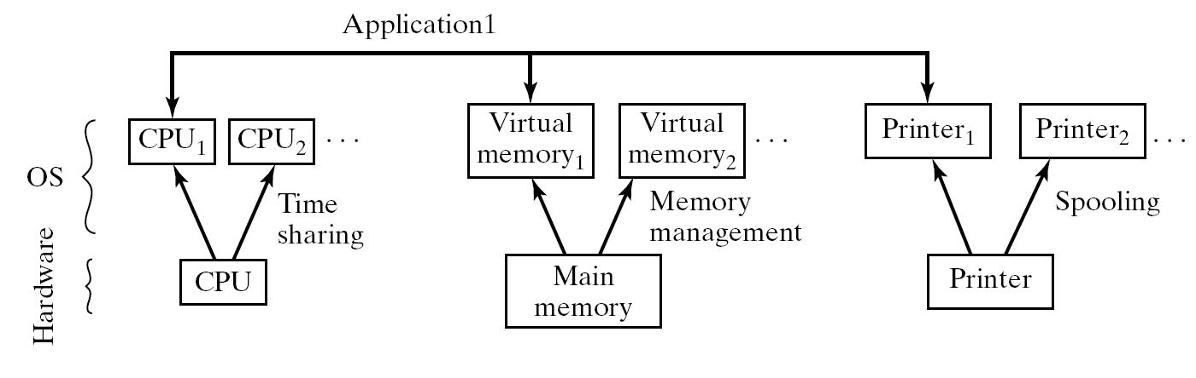
Principles of Virtualization
USTC-21000201-OPERATING SYSTEMS; FALL 2016; INSTRUCTOR: LINGBO WEI

Slide 15
Summary: OS’s Functionalities
Top-down (user) view
  the OS is a convenient application interface
    the OS hides the messy details which must be performed
    the OS presents user with a virtual machine easier to use
Bottom-up (hardware) view
  the OS performs efficient resource usage and management
    time multiplexing: each program gets to use a resource
    space multiplexing: each program gets part of a resource
Software layer view
  the OS is an evolvable and scalable software
    the OS permits effective development and introduction of new system functions without interfering with service
USTC-21000201-OPERATING SYSTEMS; FALL 2016; INSTRUCTOR: LINGBO WEI

Slide 16
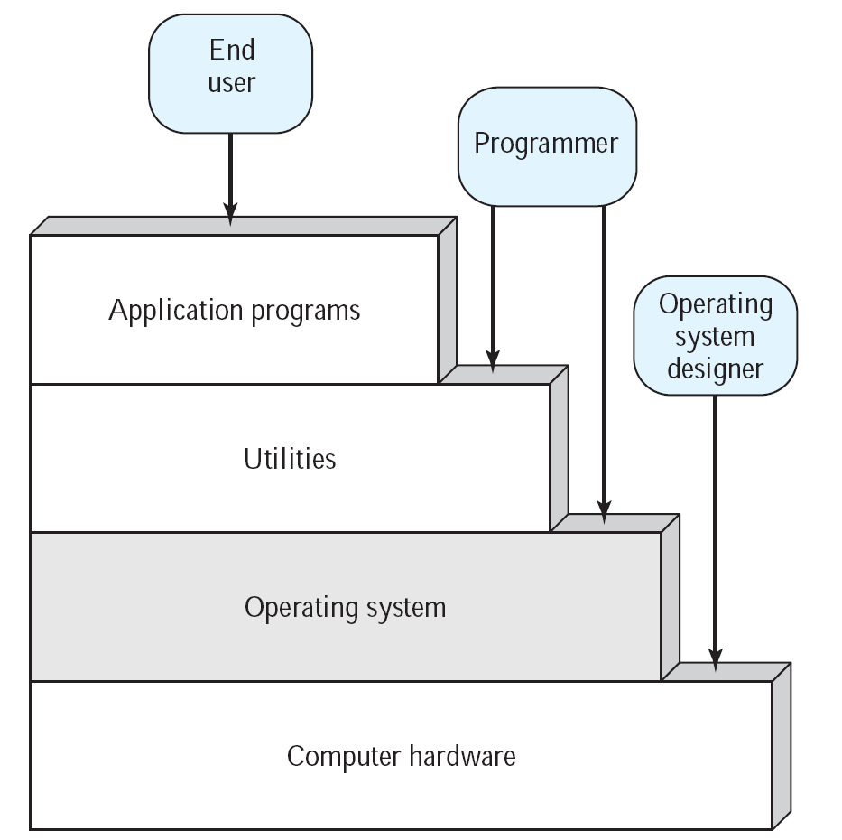
Role of an OS
The Stallings “stairs” view
    From: “Operating Systems: Internals and Design Principles” by Stallings
USTC-21000201-OPERATING SYSTEMS; FALL 2016; INSTRUCTOR: LINGBO WEI

Slide 17
Operating System Definition
No universally accepted definition
“Everything a vendor ships when you order an operating system” is good approximation
  But varies wildly
“The one program running at all times on the computer” is the kernel.
  Everything else is either a system program (ships with the operating system) or an application program
USTC-21000201-OPERATING SYSTEMS; FALL 2016; INSTRUCTOR: LINGBO WEI

Slide 18
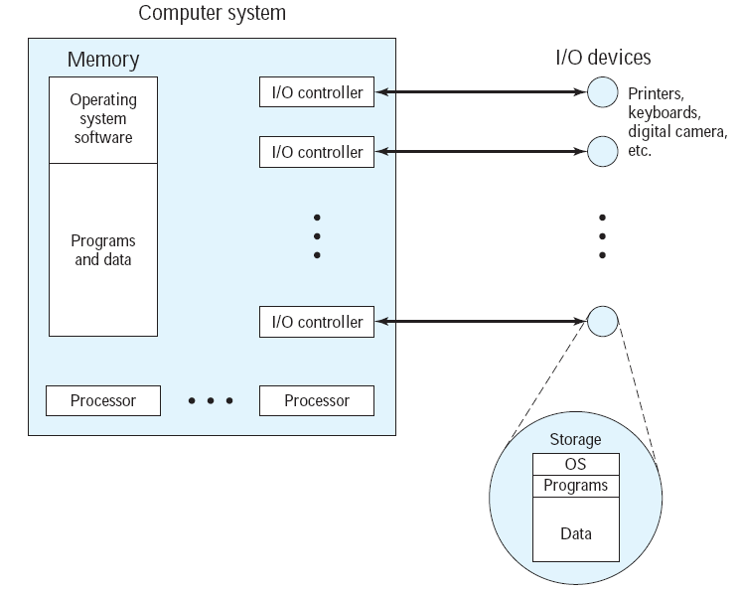
OS as a Program
传统的控制系统中，控制者与控制对象是分离的（比如供热系统与自动调温器）
OS的控制是不同的
  CPU只有一个
  只能有一个程序
  被CPU执行
  OS也是一个程序
USTC-21000201-OPERATING SYSTEMS; FALL 2016; INSTRUCTOR: LINGBO WEI
Notes:
这有两方面的含义：
一是要做成本分析。用作OS的CPU时间，对于应用来说是成本，机会成本。

Slide 19
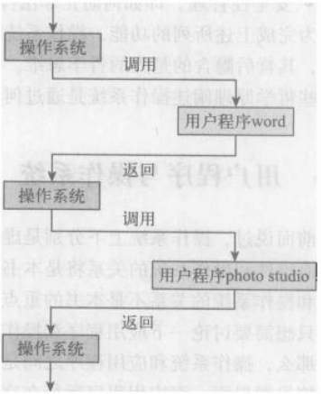
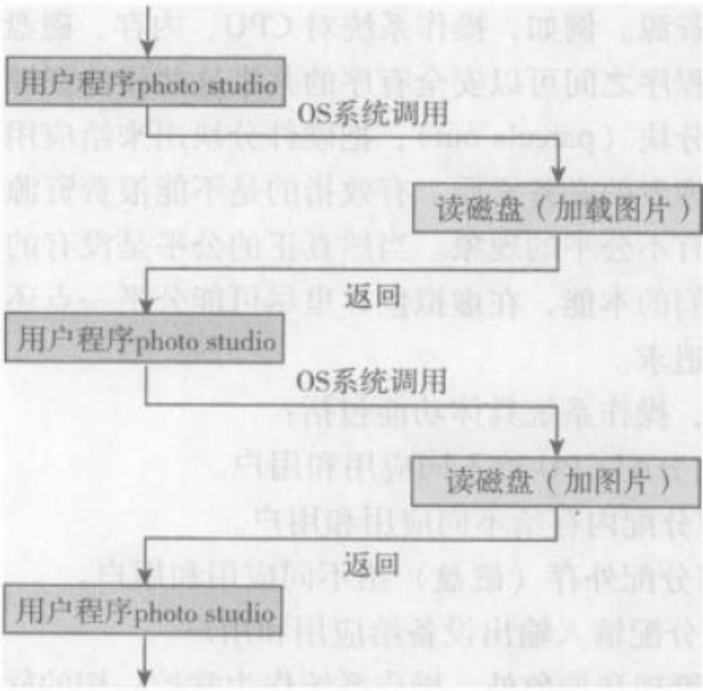
OS as a Program
用户程序为主程序，OS为子程序 OS为主程序，用户程序为子程序
USTC-21000201-OPERATING SYSTEMS; FALL 2016; INSTRUCTOR: LINGBO WEI

Slide 20

Dual Mode Operation
Hardware provides at least two modes:
  “Kernel” mode (or “supervisor” or “protected”)
  “User” mode: Normal programs executed
Some instructions/ops prohibited in user mode:
  Example: cannot modify page tables in user mode
    Attempt to modify ⇒ Exception generated
Transitions from user mode to kernel mode:
  System Calls, Interrupts, Other exceptions
USTC-21000201-OPERATING SYSTEMS; FALL 2016; INSTRUCTOR: LINGBO WEI

Slide 21
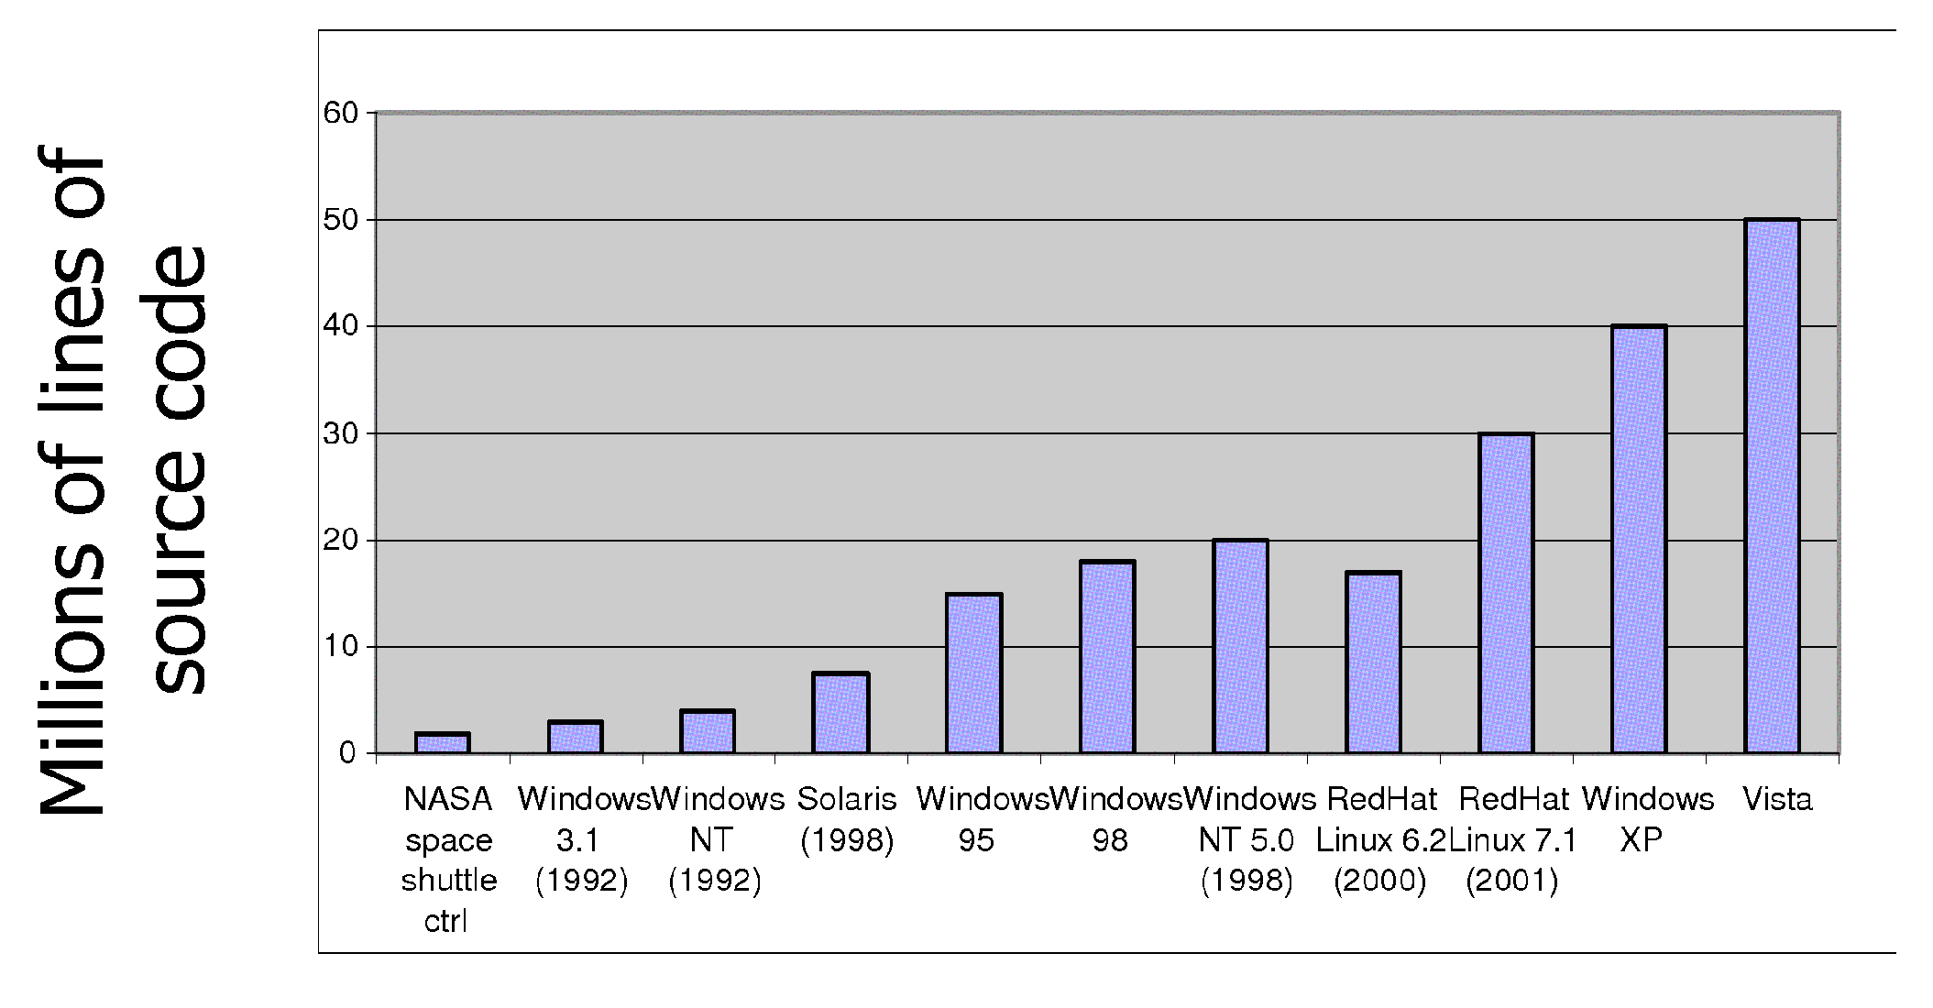
Increasing Software Complexity
From MIT’s 6.033 course
USTC-21000201-OPERATING SYSTEMS; FALL 2016; INSTRUCTOR: LINGBO WEI
Notes:
Tanenbaum的现代操作系统第13章，对OS设计的困难做了深入的描述

Slide 22

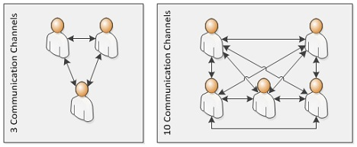
The Mythical Man Month
A programmer can produce only 1000 lines of debugged code per year on large projects
Large project design
  1/3 Planning
  1/6 Coding
  1/4 Module testing
  1/4 System testing
People and time not interchangeable
  Work cannot be fully parallelized
  Work must be partitioned into large numbers of modules
  Debugging is highly sequential
No Silver Bullet:
  better high-level languages, artificial intelligence, expert systems...
Fred Brooks
USTC-21000201-OPERATING SYSTEMS; FALL 2016; INSTRUCTOR: LINGBO WEI
Notes:
人月神话：不准确的翻译，人月迷思。史前巨兽困在沼泽中

Slide 23
为什么设计一个“好的”OS是很困难的？
根据摩尔定律，硬件每10年改进100倍，但现在的操作系统在某些方面（比如可靠性）比70年代的Unix版本7还糟糕
为什么会出现这种状况呢？
  OS的设计者对于需要什么必须非常清楚，但什么是“好的”OS并不明确
  OS所支持的app一直在以无法预期的方式快速变化
  OS无法有效地解耦成独立的模块。航空母舰比OS更复杂，但是航母能更好地分成相互隔离的部分
  没有人能理解500万行的代码，结果无法充分优化也就不奇怪了
  ……
USTC-21000201-OPERATING SYSTEMS; FALL 2016; INSTRUCTOR: LINGBO WEI

Slide 24
OS as a System
Learn how “systems” work
Main challenges in building systems
Principles of system design, i.e., how to address challenges
Learn how to apply these principles to system design
USTC-21000201-OPERATING SYSTEMS; FALL 2016; INSTRUCTOR: LINGBO WEI

Slide 25
Part 0: Introduction to OS
A Story
Role of an OS
OS Architecture
  Monolithic structure
  Layered structure
  Microkernel structure
OS History and Features
Types of OS
USTC-21000201-OPERATING SYSTEMS; FALL 2016; INSTRUCTOR: LINGBO WEI

Slide 26
Why software architecture?
Operating systems have become huge complex beasts
With code size come all the problems
  OS are chronically late in being delivered (new or upgrades)
  OS have latent bugs that pop up and must be quickly fixed
  performance is often not what was expected
  it has proven impossible to deploy an OS that is not vulnerable to security attacks
Hence the critical need for a well-engineered software architecture
  layers and/or modules with clean, minimal interfaces
  the goal is that one part can be easily changed (fixed, upgraded, expanded) without impacting the other parts
USTC-21000201-OPERATING SYSTEMS; FALL 2016; INSTRUCTOR: LINGBO WEI
Notes:
参考
Principles of Operating Systems
CS446_S06_1_Introduction4-System Calls & OS Architecture

Slide 27
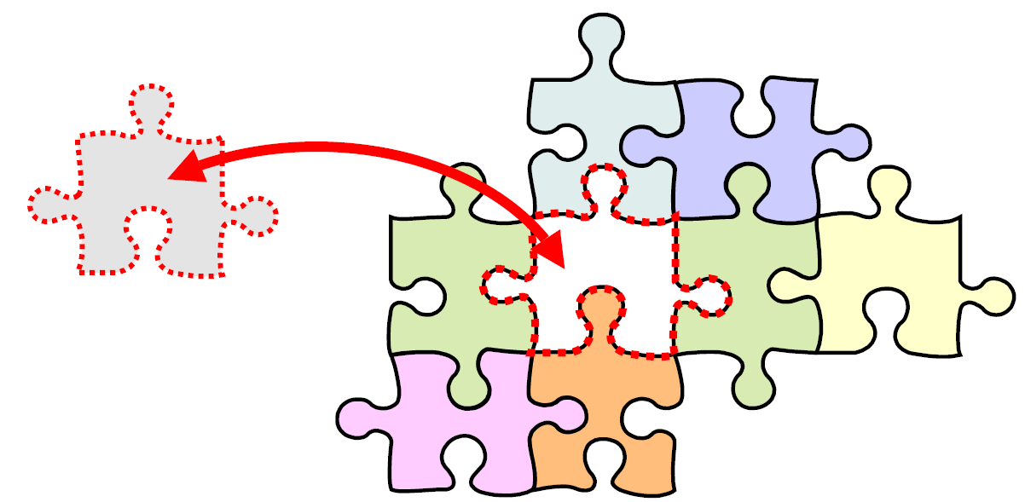
Why software architecture?
Well-defined interfaces allow part replacement without impacting the surroundings
USTC-21000201-OPERATING SYSTEMS; FALL 2016; INSTRUCTOR: LINGBO WEI

Slide 28
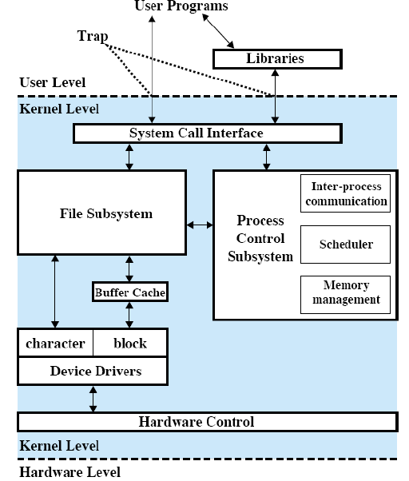
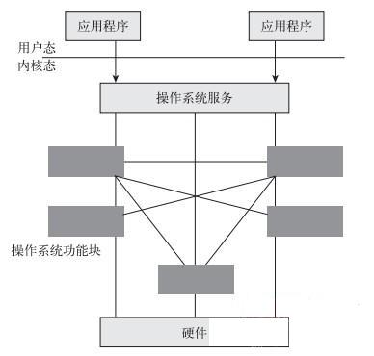
Monolithic Structure
“The Big Mess”: a collection of procedures that can call any of the other procedures whenever they need to
Bad examples: MS-DOS, original UNIX
USTC-21000201-OPERATING SYSTEMS; FALL 2016; INSTRUCTOR: LINGBO WEI

Slide 29
Layered Structure
Monolithic operating systems
  no one had experience in building truly large software systems
  the problems caused by mutual dependence and interaction were grossly underestimated
  such lack of structure became unsustainable as OS grew
Enter hierarchical layers and information abstraction
  each layer is implemented exclusively using operations provided by lower layers
  it does not need to know how they are implemented
  hence, lower layers hide the existence of certain data structures, private operations and hardware from upper layers
USTC-21000201-OPERATING SYSTEMS; FALL 2016; INSTRUCTOR: LINGBO WEI

Slide 30
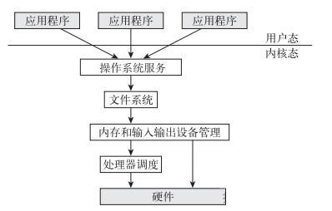
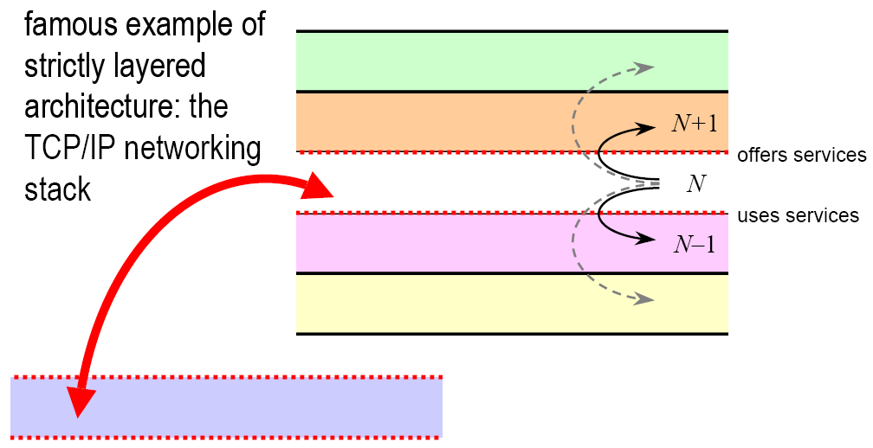
Layered Structure
Layers can be debugged and replaced independently without bothering the other layers above and below
USTC-21000201-OPERATING SYSTEMS; FALL 2016; INSTRUCTOR: LINGBO WEI

Slide 31
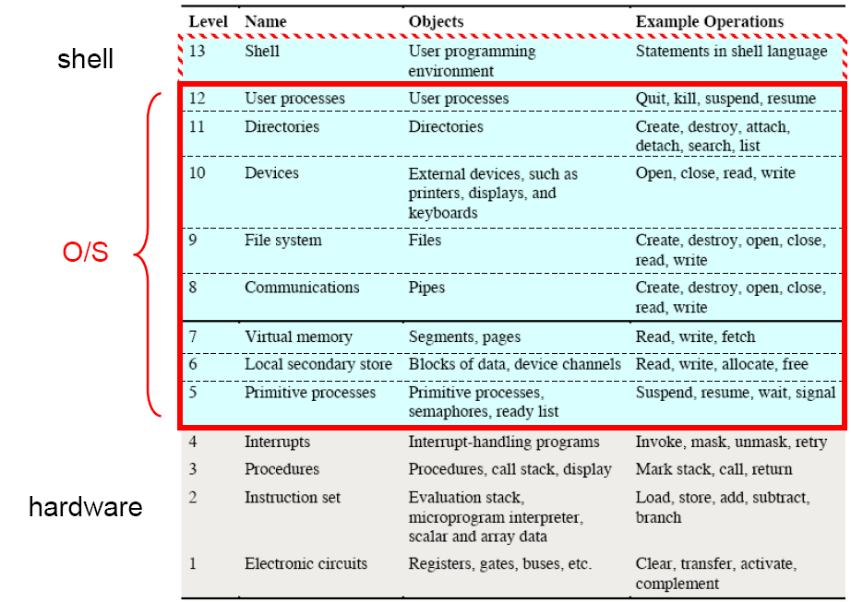
Layered Structure
Theoretical model of operating system design hierarchy
USTC-21000201-OPERATING SYSTEMS; FALL 2016; INSTRUCTOR: LINGBO WEI

Slide 32
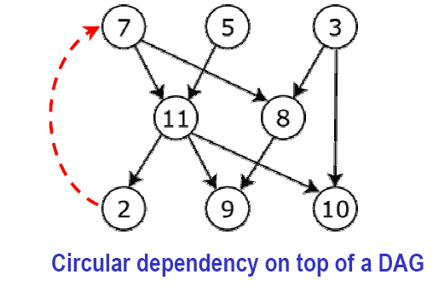
Layered Structure
Major difficulty with layering
  . . . appropriately defining the various layers!
  layering is only possible if all function dependencies can be sorted out into a Directed Acyclic Graph (DAG)
  however there might be conflicts in the form of circular dependencies (“cycles”)
USTC-21000201-OPERATING SYSTEMS; FALL 2016; INSTRUCTOR: LINGBO WEI

Slide 33
Layered Structure
Circular dependencies in an OS organization
  example: disk driver routines vs. CPU scheduler routines
Other difficulty: efficiency
  the more layers, the more indirections from function to function and the bigger the overhead in function calls
  backlash against strict layering: return to fewer layers with more functionality
USTC-21000201-OPERATING SYSTEMS; FALL 2016; INSTRUCTOR: LINGBO WEI

Slide 34
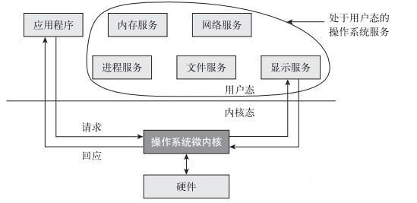
Microkernel Structure
a microkernel is a reduced operating system core that contains only essential O/S functions
the idea is to “defat” the kernel by moving up as much functionality as possible from the kernel into user space
many services traditionally included in the O/S are now external subsystems running as user processes
  device drivers
  file systems
  virtual memory manager
  windowing system
  security services, etc.
USTC-21000201-OPERATING SYSTEMS; FALL 2016; INSTRUCTOR: LINGBO WEI

Slide 35
Microkernel Structure
Benefits of the microkernel approach
  extensibility—it is easier to extend a microkernel-based O/S as new services are added in user space, not in the kernel
  portability—it is easier to port to a new CPU, as changes are needed only in the microkernel, not in the other services
  reliability & security—much less code is running in kernel mode; failures in user-space services don’t affect kernel space
Detriments of the microkernel approach
  again, performance overhead due to communication from user space to kernel space
  not always realistic: some functions (I/O) must remain in kernel space, forcing a separation between “policy” and “mechanism”
USTC-21000201-OPERATING SYSTEMS; FALL 2016; INSTRUCTOR: LINGBO WEI

Slide 36
Part 0: Introduction to OS
A Story
Role of an OS
OS Architecture
OS History and Features
  Serial processing
  batch systems
  Multiprogramming
  Time-sharing systems
Types of OS
USTC-21000201-OPERATING SYSTEMS; FALL 2016; INSTRUCTOR: LINGBO WEI

Slide 37
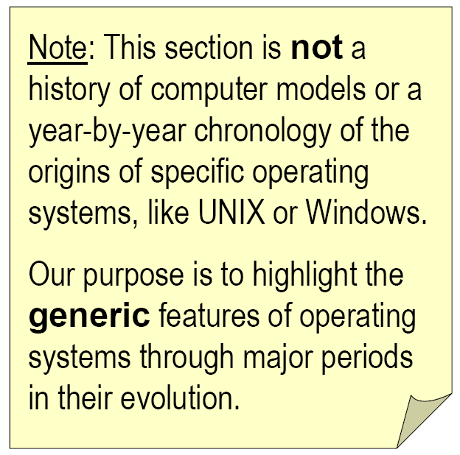
History of Operating Systems
Generations
  1945–1955
    Vacuum Tubes
    Serial Processing
  1955–1965
    Transistors
    Batch Systems
  1965–1980
    ICs
    Multiprogramming
    Time-sharing systems
  1980–Present
    LSIs & Personal Computers
USTC-21000201-OPERATING SYSTEMS; FALL 2016; INSTRUCTOR: LINGBO WEI
Notes:
真空管和穿孔卡片
晶体管和批处理
集成电路和多道程序设计
大规模集成电路

Slide 38
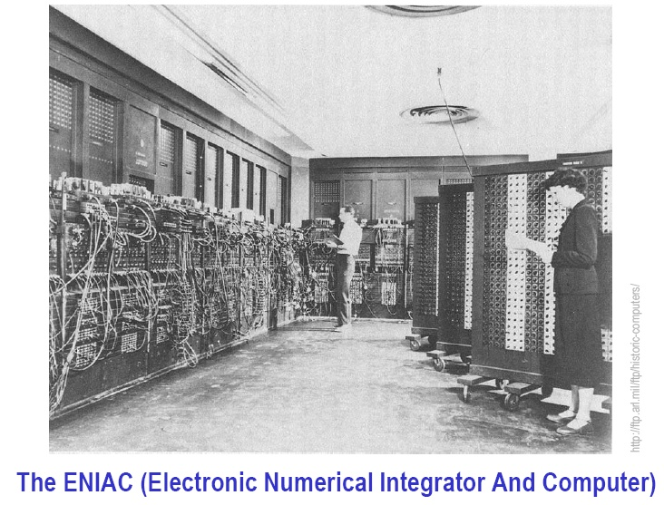
Serial Processing
First generation: 1945–1955
  room full of armoires: mechanical relays, then vacuum tubes
USTC-21000201-OPERATING SYSTEMS; FALL 2016; INSTRUCTOR: LINGBO WEI

Slide 39
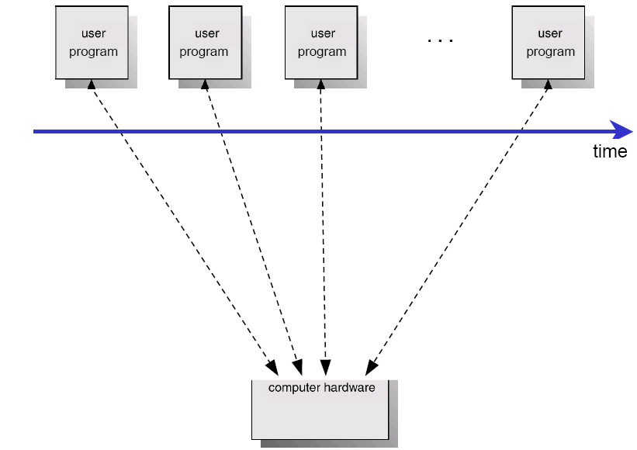
Serial Processing
Human operator-programmer-user
Operating systems were unheard of
Programs directly access the hardware, one at a time
USTC-21000201-OPERATING SYSTEMS; FALL 2016; INSTRUCTOR: LINGBO WEI

Slide 40
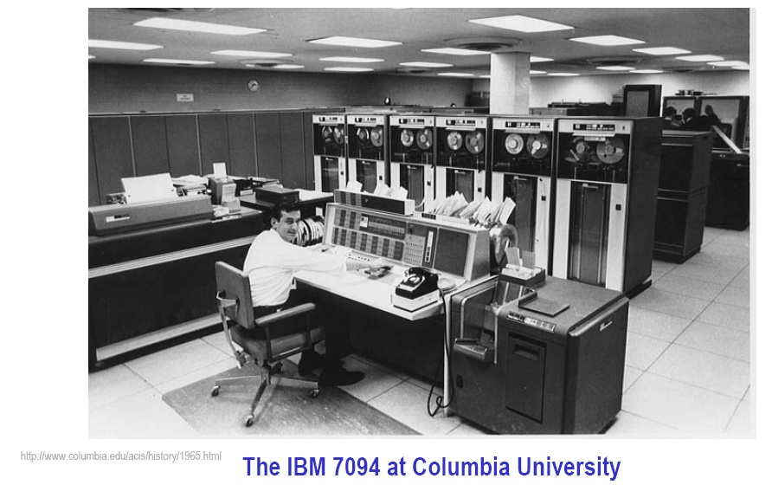
Batch Systems
Second generation: 1955–1965
  advent of transistors and printed circuits
USTC-21000201-OPERATING SYSTEMS; FALL 2016; INSTRUCTOR: LINGBO WEI

Slide 41
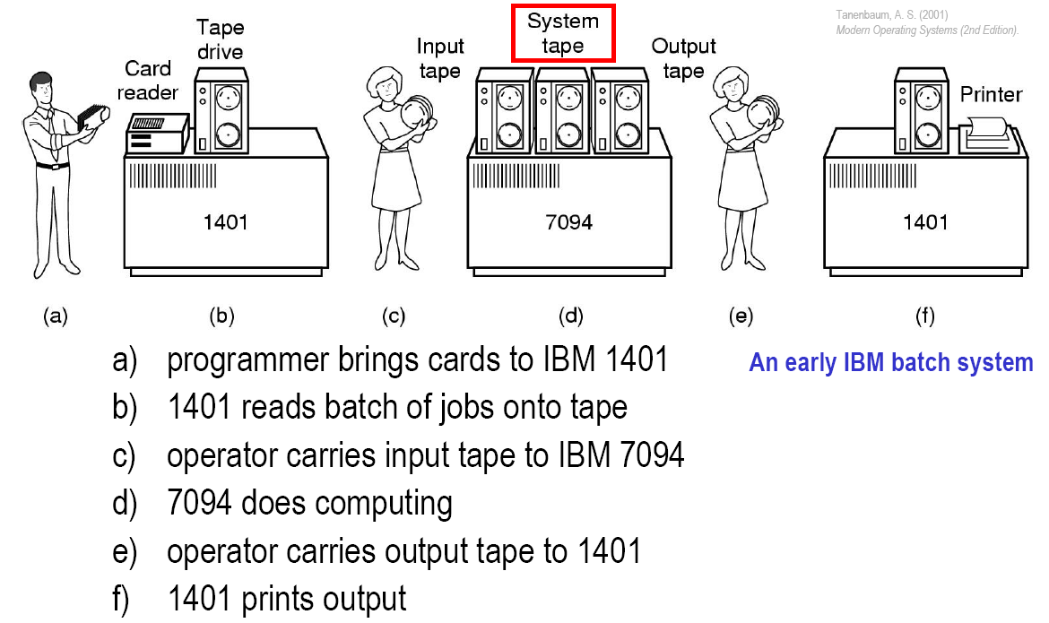
Batch Systems
USTC-21000201-OPERATING SYSTEMS; FALL 2016; INSTRUCTOR: LINGBO WEI

Slide 42
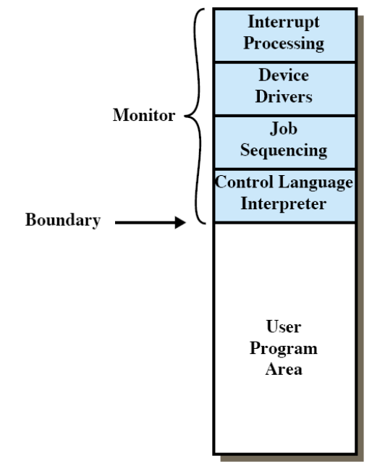
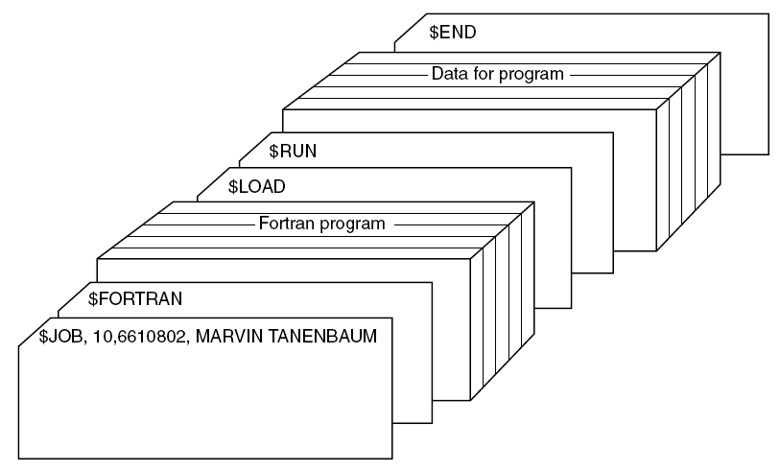
Batch Systems
job card structure
Memory layout for
a resident monitor
USTC-21000201-OPERATING SYSTEMS; FALL 2016; INSTRUCTOR: LINGBO WEI

Slide 43
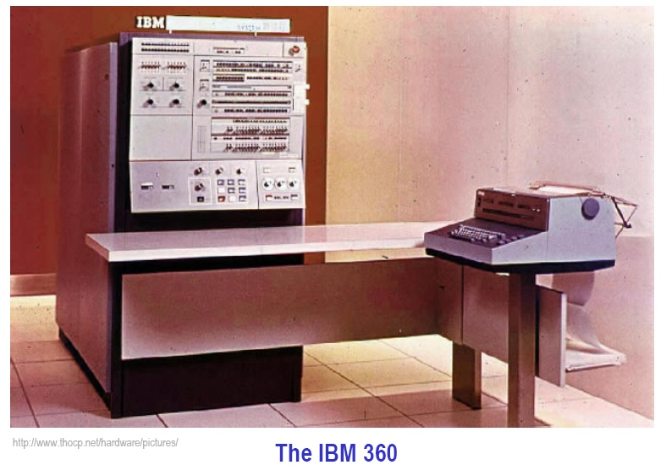
Multiprogramming
Third generation: 1965-1980
  first major use of small-scale Integrated Circuits (ICs)
USTC-21000201-OPERATING SYSTEMS; FALL 2016; INSTRUCTOR: LINGBO WEI

Slide 44
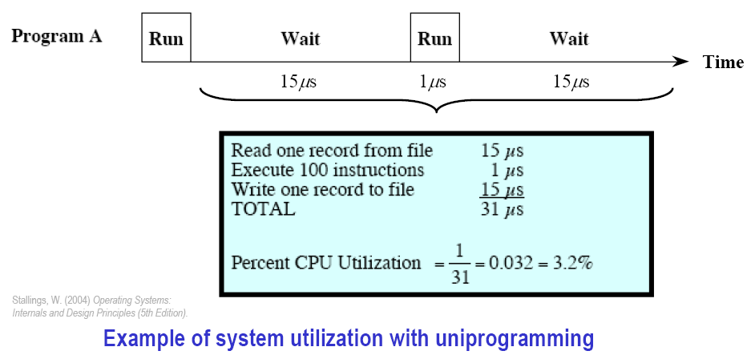
Multiprogramming
Problem: despite batching, a lot of CPU time is still wasted waiting for I/O instructions to complete
  I/O devices much slower than processor (especially tapes!)
USTC-21000201-OPERATING SYSTEMS; FALL 2016; INSTRUCTOR: LINGBO WEI

Slide 45
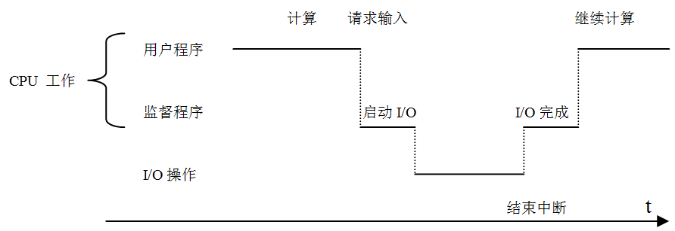
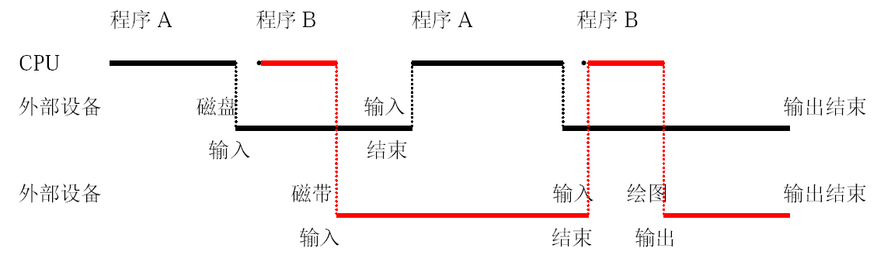
Multiprogramming
Uni-programming
Multiprogramming
USTC-21000201-OPERATING SYSTEMS; FALL 2016; INSTRUCTOR: LINGBO WEI

Slide 46
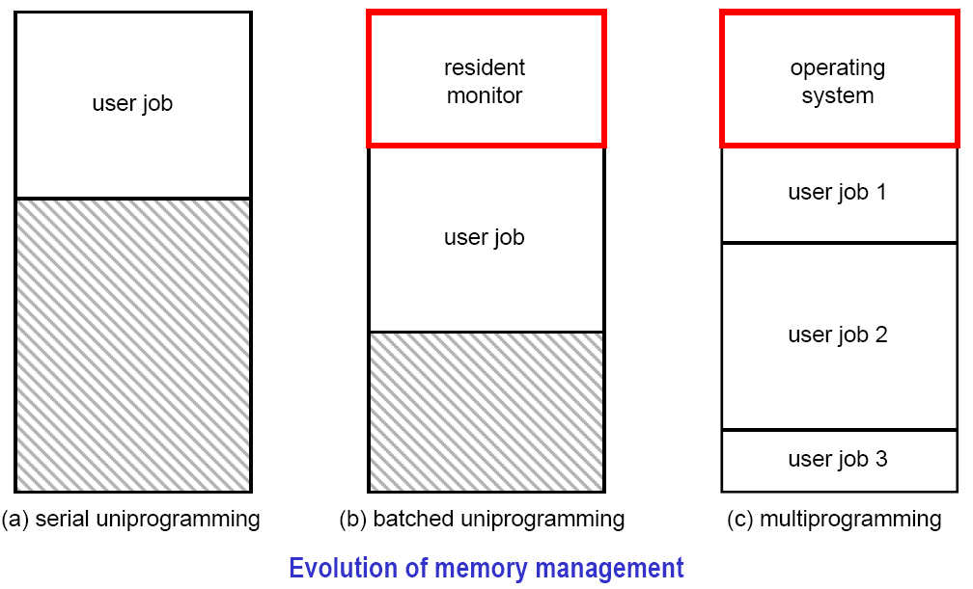
Multiprogramming
Summary: serial, batched uni-, and multiprogramming
USTC-21000201-OPERATING SYSTEMS; FALL 2016; INSTRUCTOR: LINGBO WEI

Slide 47
Time-sharing Systems
There was a need for multiple-user interactivity
  multiprogramming alone does not give any guarantee that a program will run in a timely manner
  each user wants to see their program running as if it was the only program in the computer
In the original multiprogramming systems
  tasks kept running until they performed an operation that required waiting for an external event such as I/O
  multiprogramming was designed to maximize CPU usage
In time-sharing systems
  running tasks are required to relinquish the CPU on a regular basis through hardware interrupts (timer)
  time-sharing is designed to minimize response time and allow several programs to execute apparently simultaneously
  time sharing is a logical extension of multiprogramming for handling multiple interactive jobs among multiple users
USTC-21000201-OPERATING SYSTEMS; FALL 2016; INSTRUCTOR: LINGBO WEI

Slide 48
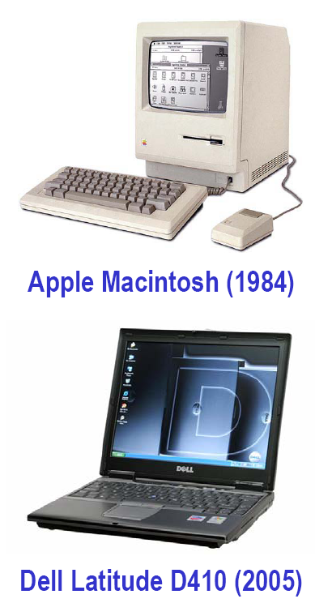
Personal Computers
Fourth generation: 1980-Present
  Large Scale Integration (LSI) makes personal computing real
  From multiple users back to a single user
    preemptive multitasking was developed in the 1960’s to share big and costly mainframe computers among multiple users
    since then, single-user interactive computing has become possible on dedicated personal computers
  Resource sharing not critical anymore, yet multitasking still a central feature of modern PC operating systems
    a single-tasking environment is tedious: one must close the drawing application before opening the word processor, etc.
    in time-sharing systems, the primary goal of PC systems is to maximize user convenience and responsiveness
USTC-21000201-OPERATING SYSTEMS; FALL 2016; INSTRUCTOR: LINGBO WEI

Slide 49
Part 0: Introduction to OS
A Story
Role of an OS
OS Architecture
OS History and Features
Types of OS
  Mainframe systems
  Desktop & laptop systems
  Parallel systems
  Real-time systems
USTC-21000201-OPERATING SYSTEMS; FALL 2016; INSTRUCTOR: LINGBO WEI

Slide 50
In Conclusion…
OS as illusionist:
  Make hardware limitations go away
  Provide illusion of dedicated machine with infinite memory and infinite processors
OS as government:
  Protect users from each other
  Allocate resources efficiently and fairly
OS as history teacher
  Learn from past
  Adapt as hardware tradeoffs change
OS as complex system:
  Constant tension between simplicity and functionality or performance
USTC-21000201-OPERATING SYSTEMS; FALL 2016; INSTRUCTOR: LINGBO WEI

Slide 51
After the class…
Reading:
  教材第一章：硬件知识回顾 pp.1-45 (7th Edition)
  教材第二章：操作系统概述 pp.46-104 (7th Edition)
Homework:
  P37: Problems 1.3, 1.4, 1.7, 1.8, 1.9 (7th Edition)
  P104: Problems 2.1, 2.2, 2.3, 2.4, 2.6 (7th Edition)
Online materials (including lecture notes):
  http://staff.ustc.edu.cn/~chizhang/OS/
USTC-21000201-OPERATING SYSTEMS; FALL 2016; INSTRUCTOR: LINGBO WEI

